Slide 1
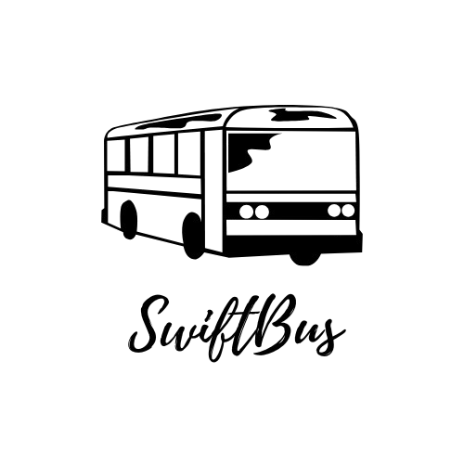
Bus Ticket Booking System
By: Vaishnavi Suresh Vaidyanath
Mentor:JAVEED MOHAMMED HUSNUDDIN

Slide 2
Technologies and Tools used
Backend-Java with Spring Boot , Hibernate and JPA
JWT for authentication and authorization
Database :MySQL
Frontend UI-ReactJS
CSS/Bootstrap
Deployment – Docker and AWS S3

Slide 3
Project Overview
This is a bus-ticket-booking- system where there are 3 roles:
1. User
Register and Login
Create Profile
Search buses based on routes(origin and destination) and date
Available buses are displayed and user can select desired number of seats and price is calculated based on number of seats selected.
Proceed to payment after confirming booking.
Manage the bookings

Slide 4
Project Overview
2. Bus Operator
Register but only login after Admin gives the approval
Add/Edit/Delete Buses , Routes and trips
View and manage bookings made by users
Refund money to user for a cancelled booking
3. Admin
Provide approval to a registered bus operator to Login and access dashboard
Manage the Bus Operators and Users
Manage bookings ,routes , trips and buses.

Slide 5
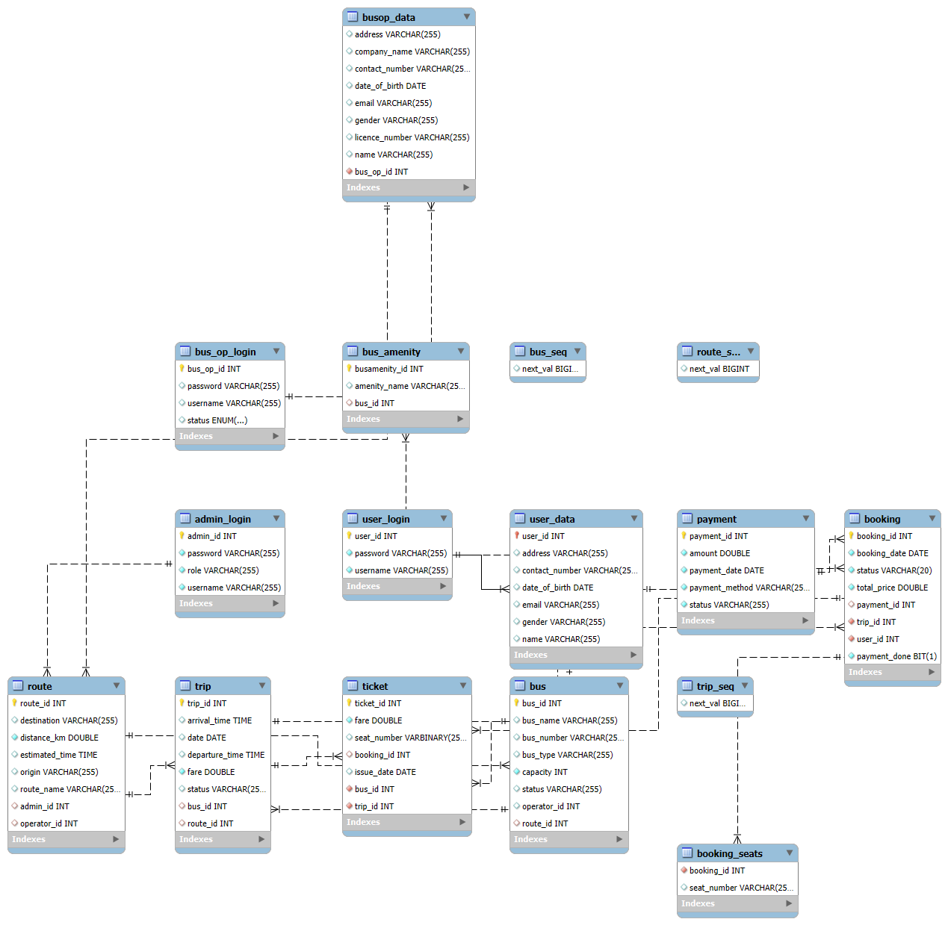
ER Diagram

Slide 6
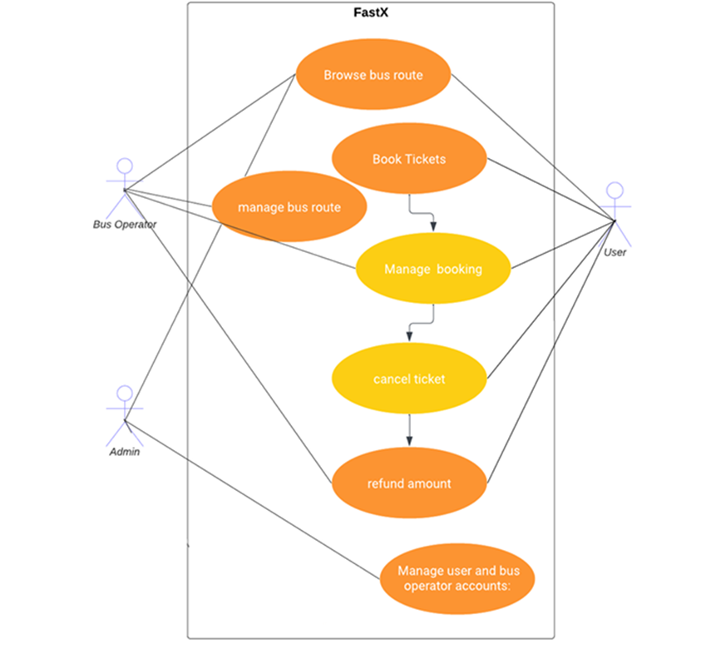
Use Case Diagram

Slide 7
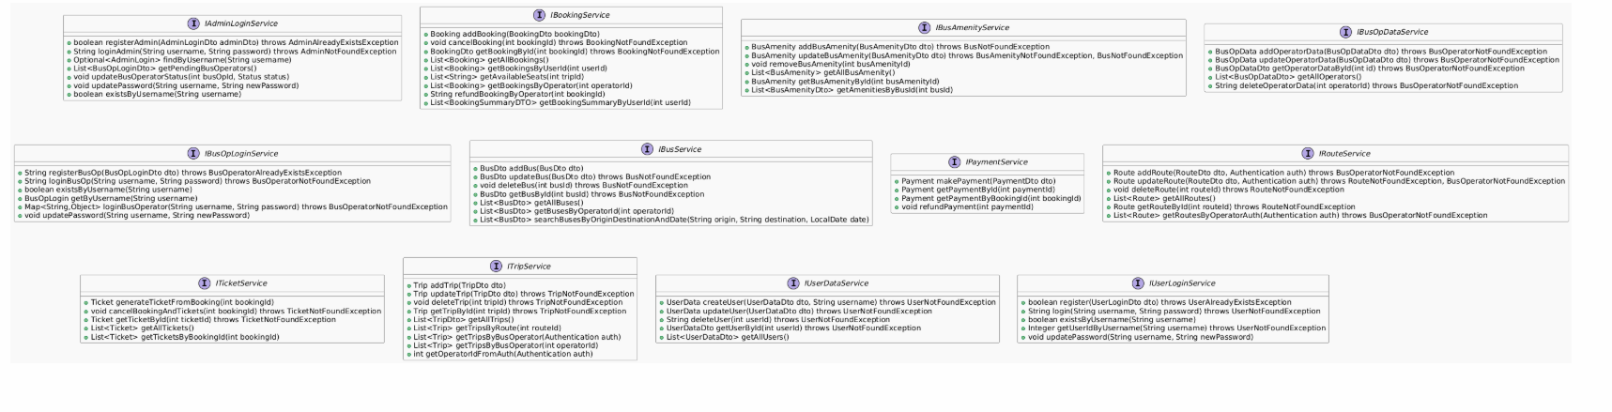
Class Diagram

Slide 8
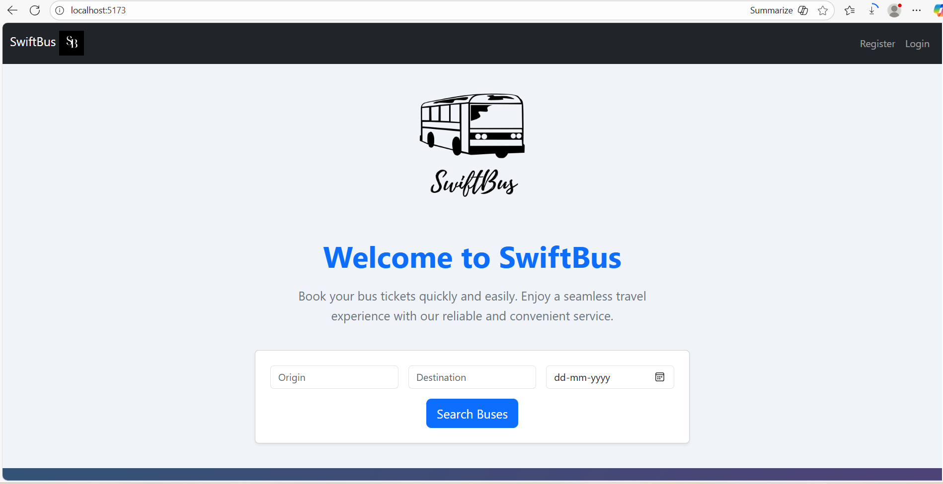
Home Page

Slide 9
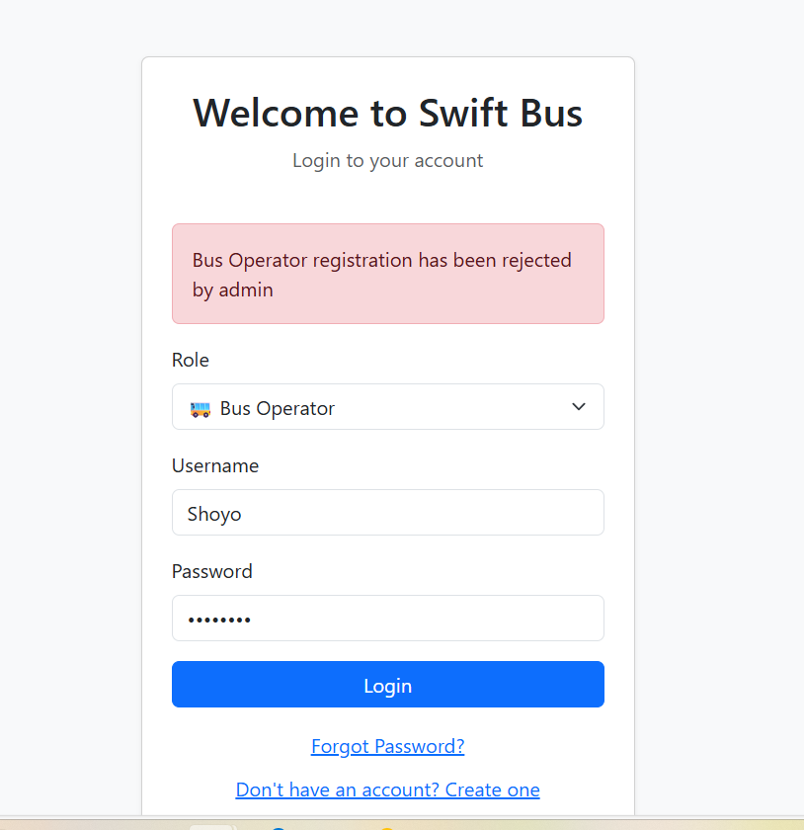
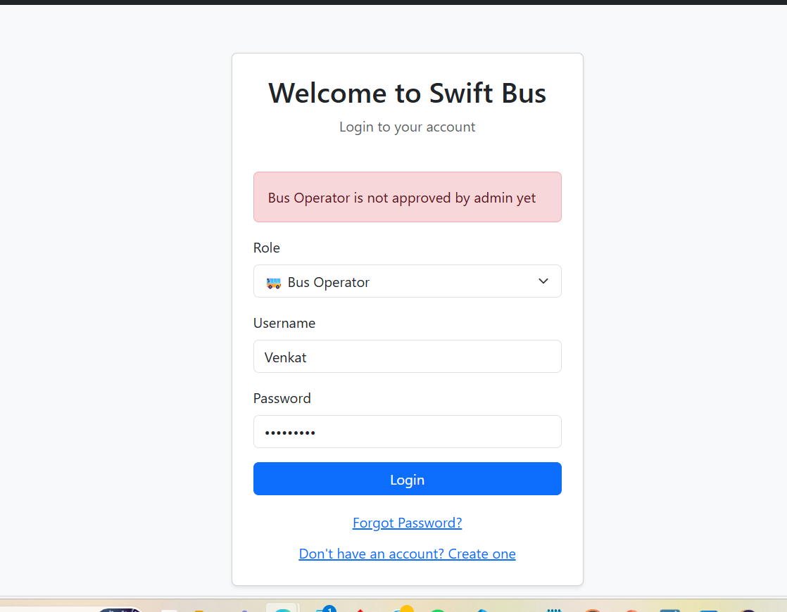
Bus Operator Login

Slide 10
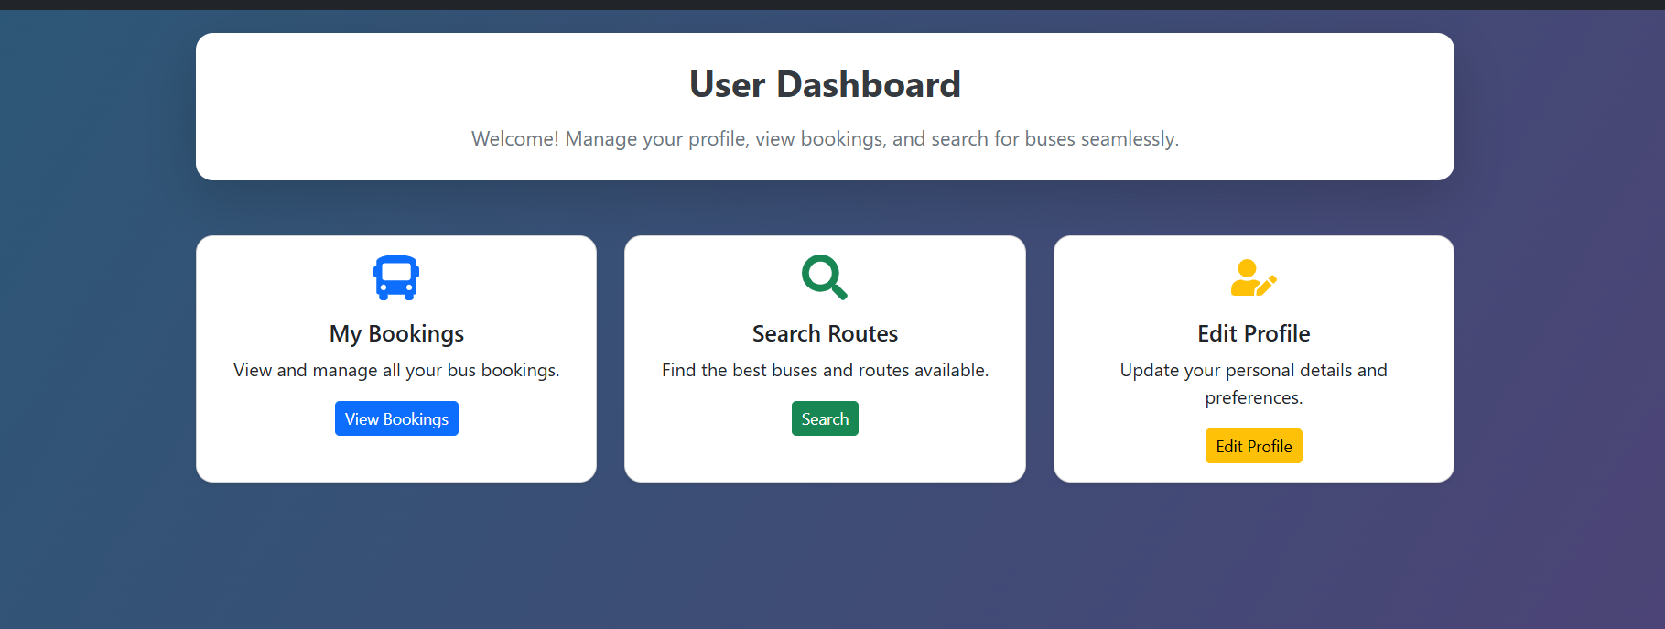
User Dashboard

Slide 11
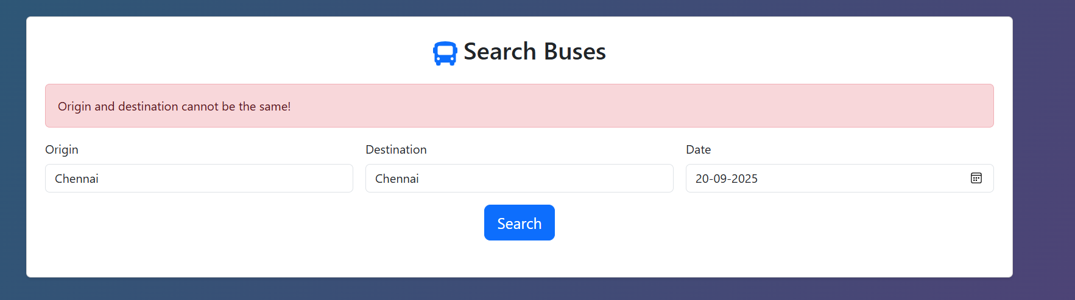
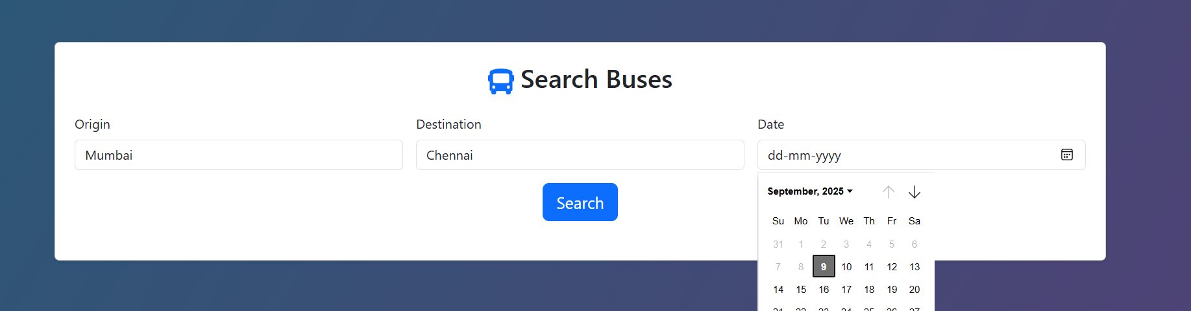
Search Bus Validation

Slide 12
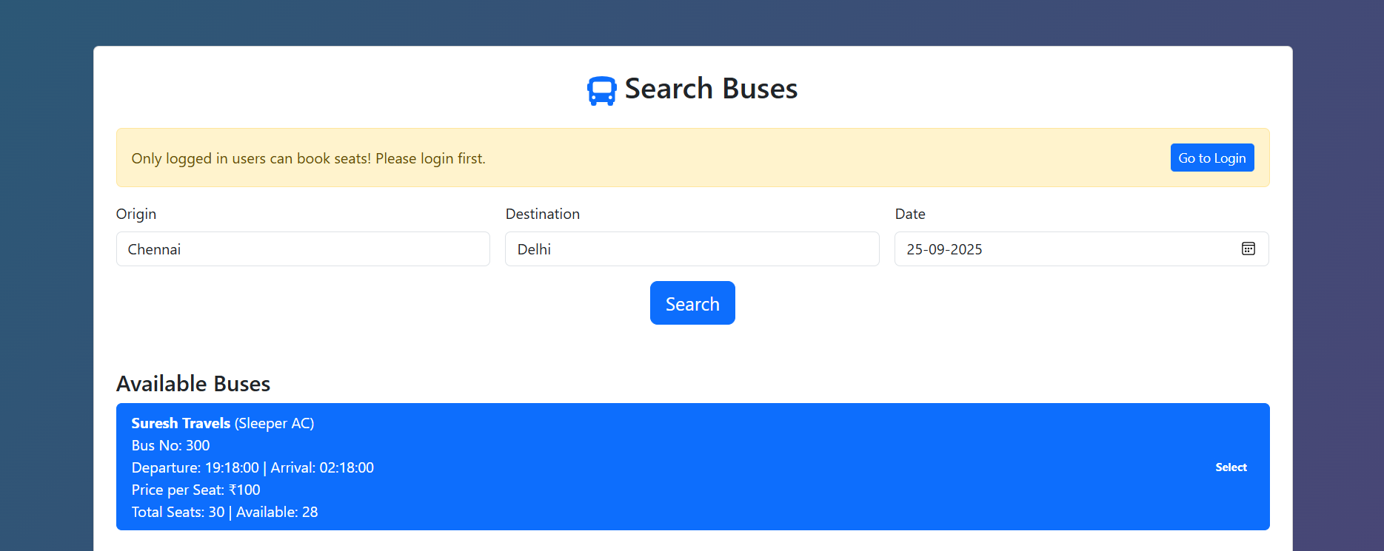
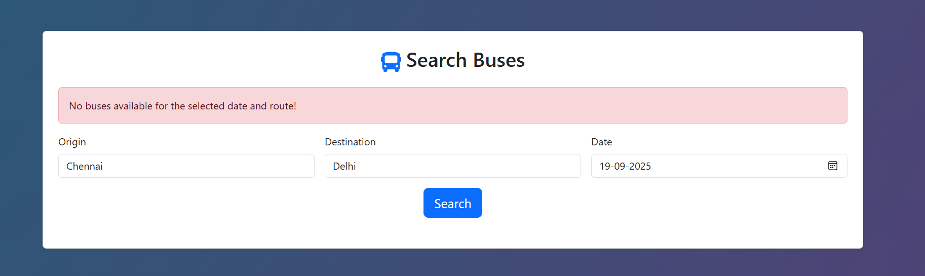
Search Bus Validations

Slide 13
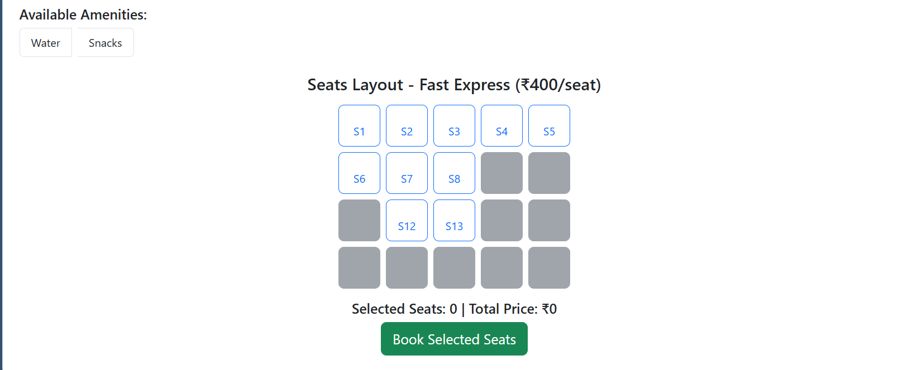
Seat Layout

Slide 14
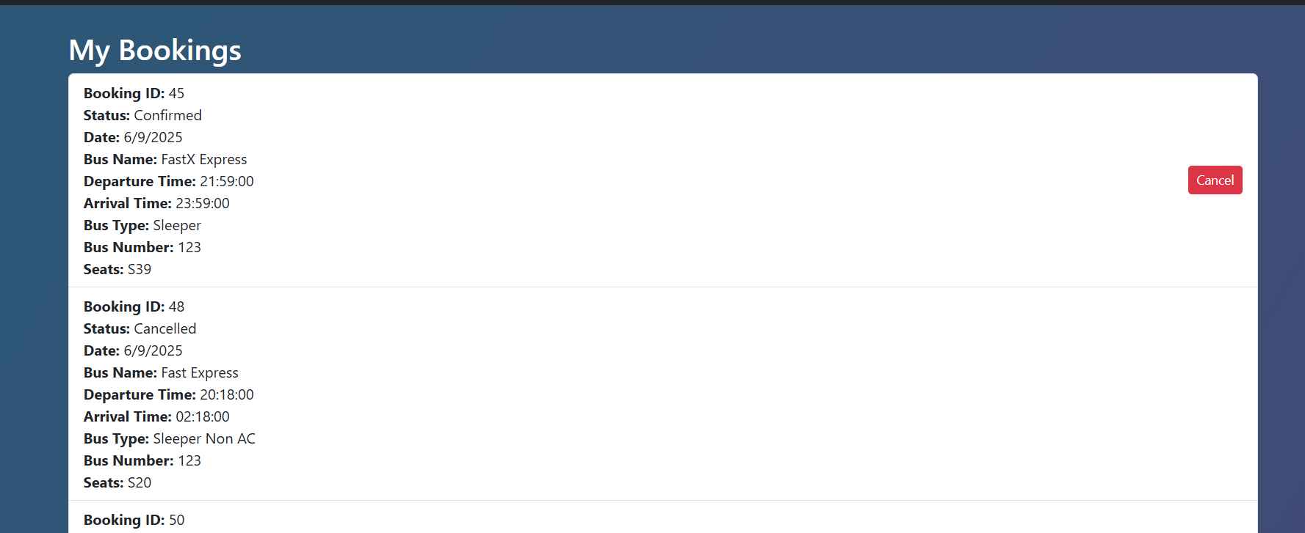
Manage Bookings

Slide 15
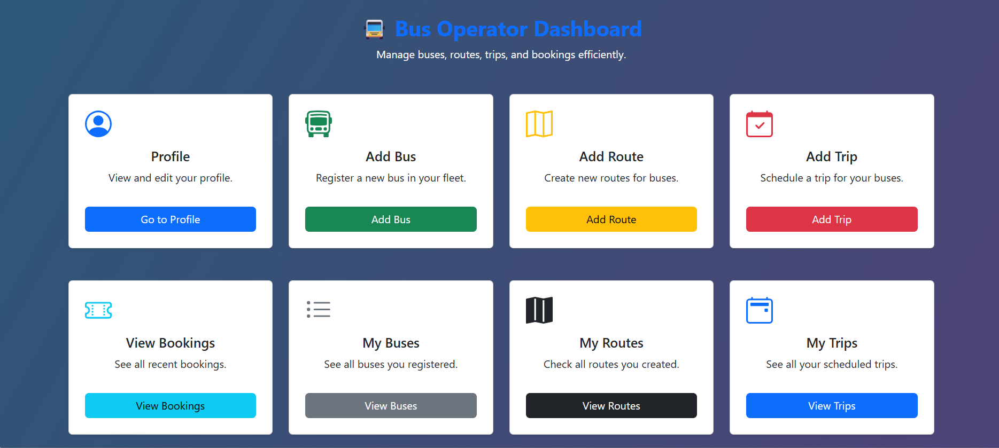
Bus Operator Dashboard

Slide 16
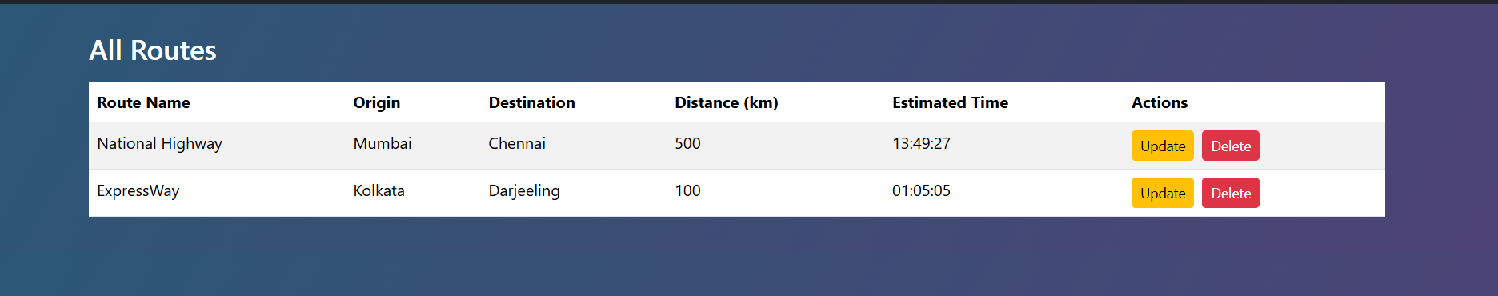
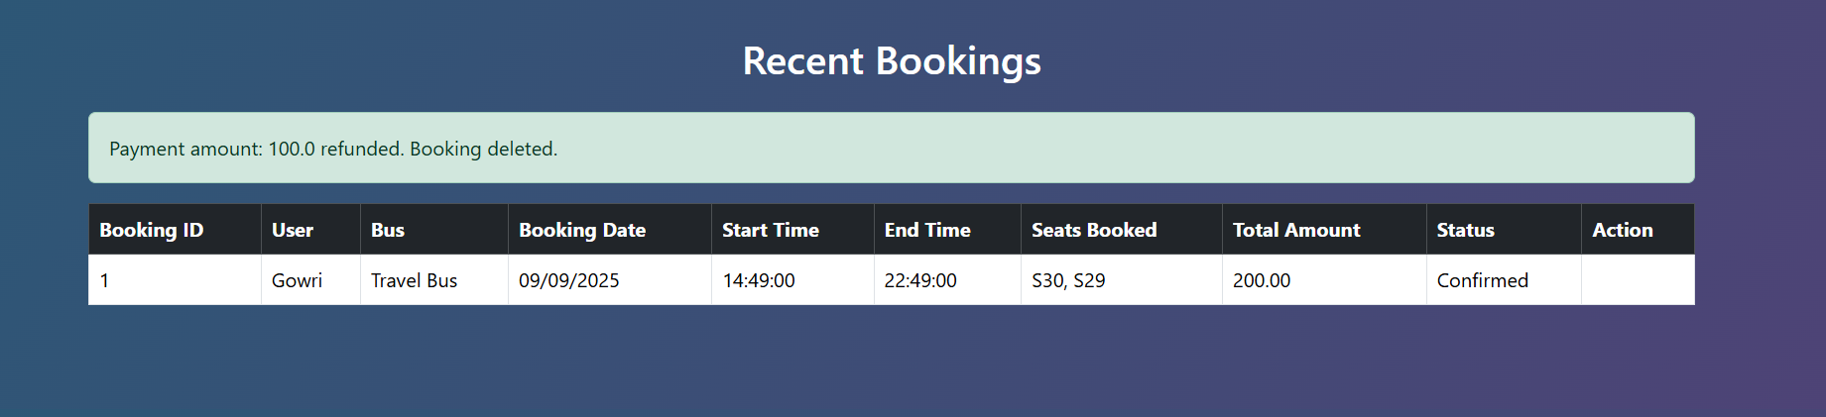
Bus Operator Operations

Slide 17
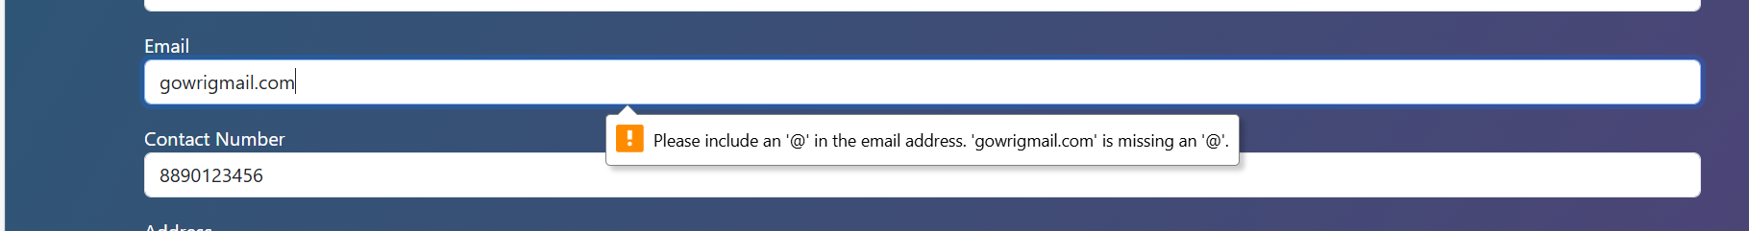
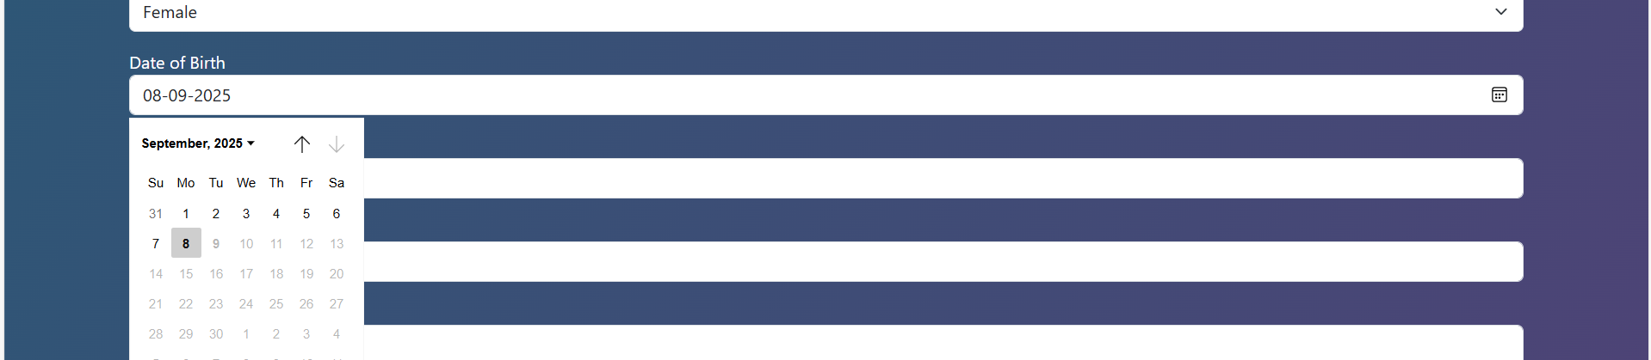
Validations in Create Profile

Slide 18
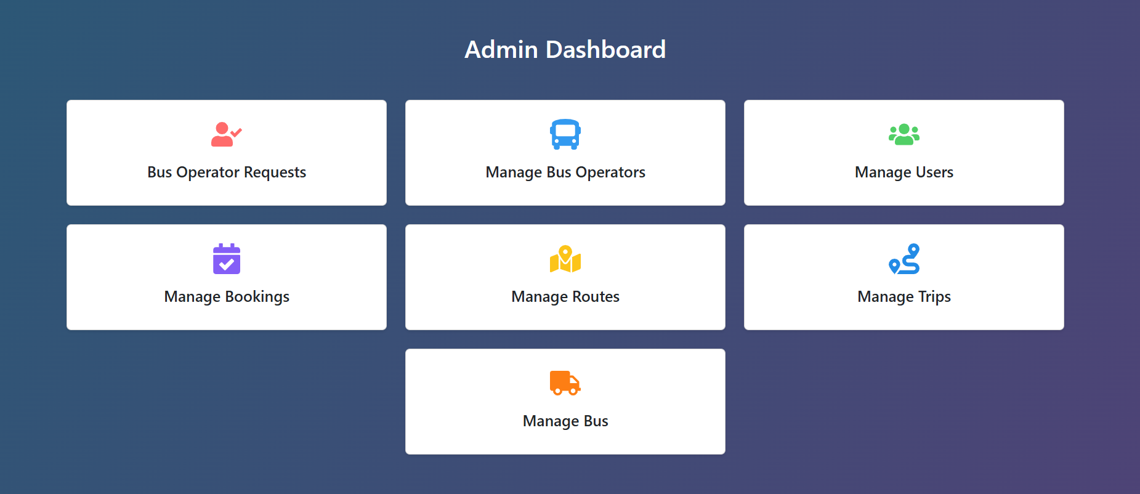
Admin Dashboard

Slide 19
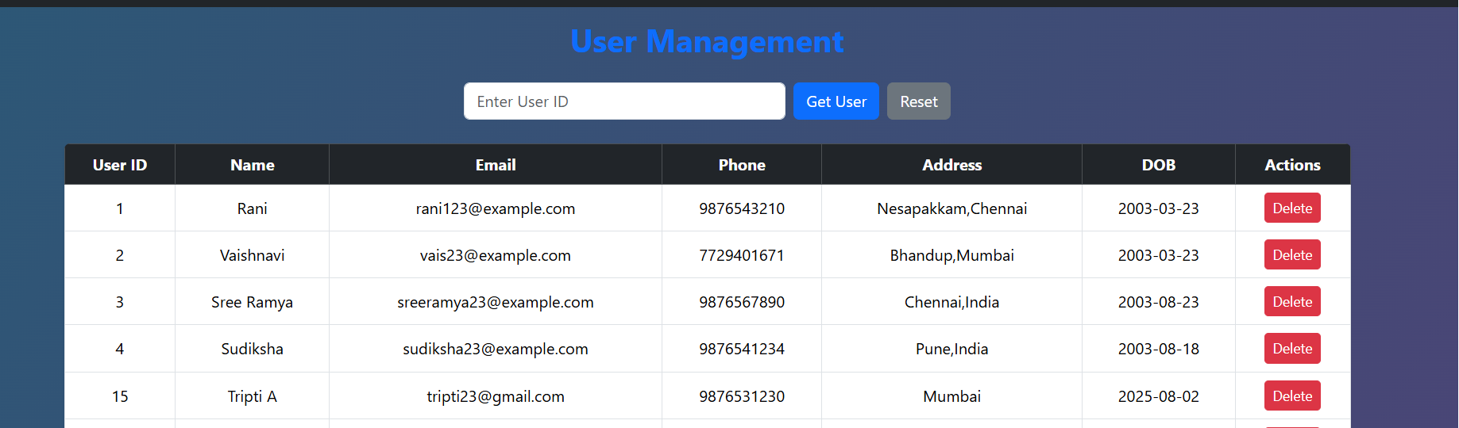
User Management By Admin

Slide 20
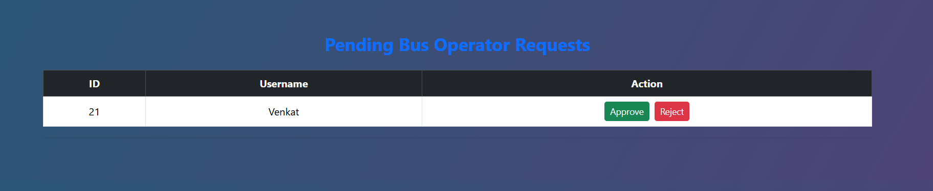
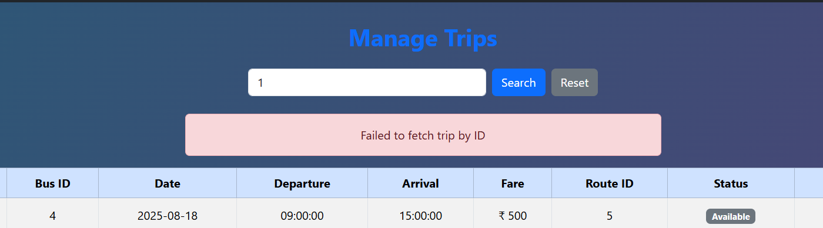
Admin Operations

Slide 21
Thank You

